Slide 1
Standard Library Functions
Python, as well as most other programming languages, comes with a standard library of functions that have already been written for you.
These functions, known as library functions, make a programmer’s job easier because they perform many of the tasks that programmers commonly need to perform.
Some of the functions that you have used are print, input, and range.

Slide 2
Standard Library Functions: Modules
In order to call a function that is stored in a module, you have to write an import statement at the top of your program.
An import statement tells the interpreter the name of the module that contains the function.
Because you do not see the internal workings of library functions, many programmers think of them as black boxes.

Slide 3
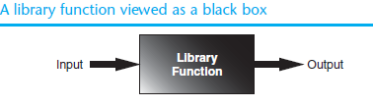
This section demonstrates how functions work by looking at standard library functions that generate random numbers, and some interesting programs that can be written with them. Then you will learn to write your own value-returning functions and how to create your own modules.

Slide 4
Generating Random Numbers
Random numbers are useful for lots of different programming tasks. The following are just a few examples.
• Random numbers are commonly used in games.
• Random numbers are useful in simulation programs.
• Random numbers are useful in statistical programs that must
randomly select data for analysis.
• Random numbers are commonly used in computer security to
encrypt sensitive data.

Slide 5
Python provides several library functions for working with random numbers. These functions are stored in a module named random in the standard library. To use any of these functions you first need to write this import statement at the top of your program:
import random
This statement causes the interpreter to load the contents of the random module into memory. This makes all of the functions in the random module available to your program.

Slide 6
On the left side of the dot (period) is the name of the module, and on the right side of the dot is the name of the function.
The following statement shows an example of how you might call the randint function.
number = random.randint(1, 100)

Slide 7
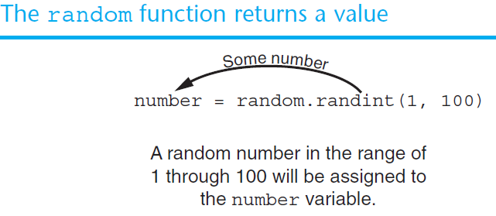

Slide 8
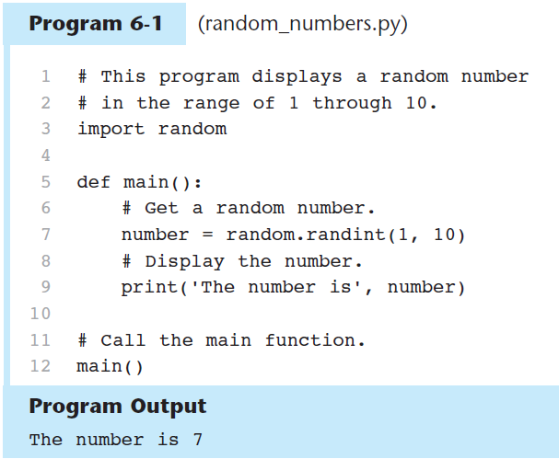

Slide 9
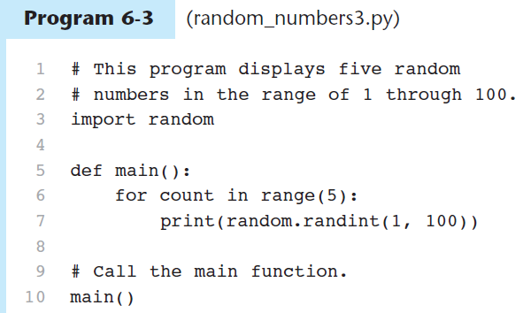
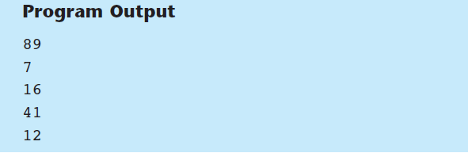
En clase

Slide 10
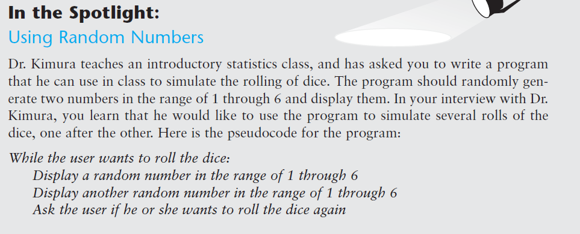
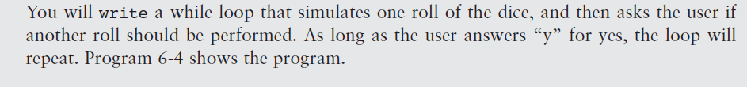


Slide 11
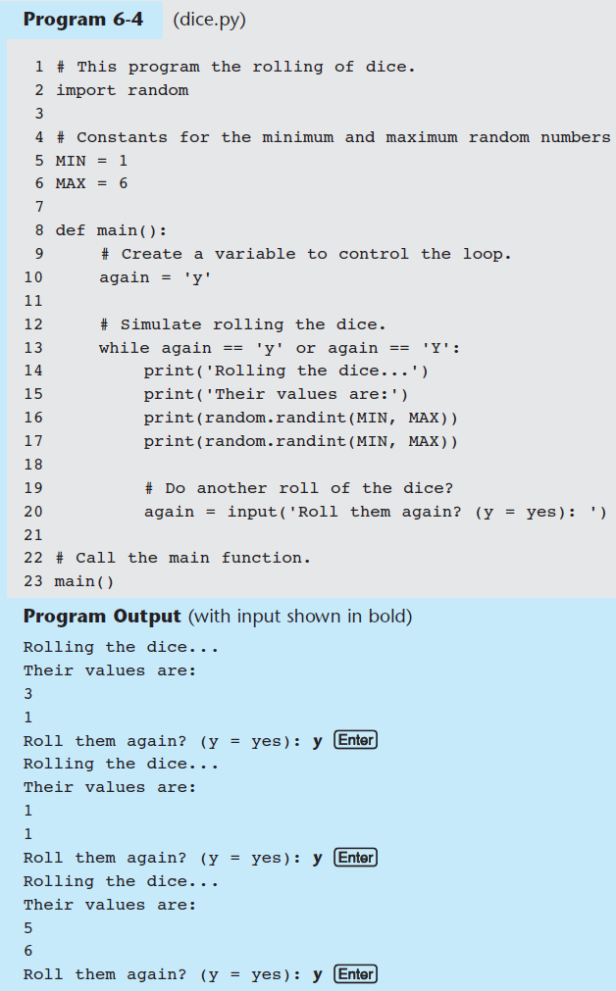
En clase

Slide 13
Here is a statement that uses the randint function in a math expression:
x = random.randint (1, 10) * 2

Slide 14
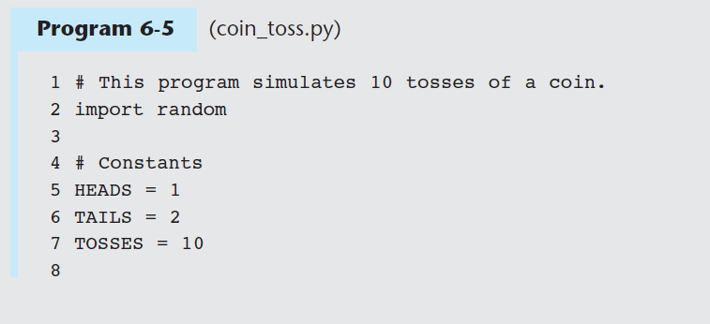
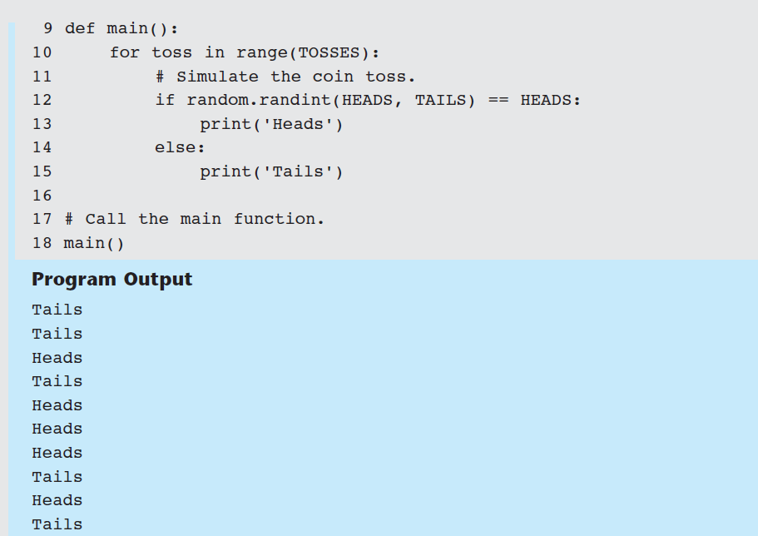
En clase
(10) :
t (1, 2) == 1:

Slide 16
The randrange, random
number = random.randrange(0, 101, 10)
In this statement the randrange function returns a randomly selected value from the following sequence of numbers:
[0, 10, 20, 30, 40, 50, 60, 70, 80, 90, 100]
The random function returns, a random floating-point number. You do not pass any arguments to the random function. When you call it, it returns a random floating point number in the range of 0.0 up to 1.0 (but not including 1.0).
number = random.random()

Slide 17
Checkpoint
6.4 What does the following statement do?
x = random.randint (1, 100)
6.5 What does the following statement do?
print (random.randint (1, 20))
6.6 What does the following statement do?
print (random.randrange (10, 20))
6.7 What does the following statement do?
print (random.random ())

